Slide 1
Building a Bluetooth-Controlled Arduino Car with Obstacle Avoidance

Slide 2
Introduction
Today, I'll be presenting our project: a Bluetooth-controlled Arduino car that can autonomously avoid obstacles. The goal of this project was to develop a basic autonomous vehicle prototype using accessible and cost-effective components.

Slide 3
Components & Materials
Arduino Uno: The central controller for all vehicle functions.
HC-05 Bluetooth Module: Enables remote control via Bluetooth.
HC-SR04 Ultrasonic Sensor: Detects obstacles in the car’s path.
L293D Motor Driver Module: Manages the operation of the motors.
Motors and Wheels: Provide movement to the car.
Battery Pack: Powers the entire setup. Each component is essential for the operation and functionality of our car.“
Servo Motor SG90: Used to rotate the ultrasonic sensor, allowing it to scan a wider area for obstacles.

Slide 4
Arduino Uno
The Arduino Uno is a microcontroller board based on the ATmega328P. It features 14 digital input/output pins (of which 6 can be used as PWM outputs), 6 analog inputs, a 16 MHz quartz crystal, a USB connection, a power jack, an ICSP header, and a reset button. It contains everything needed to support the microcontroller; simply connect it to a computer with a USB cable or power it with an AC-to-DC adapter or battery to get started. In this project, it serves as the central controller, managing all the vehicle’s functions based on the inputs it receives from the sensors and the Bluetooth module.

Slide 5
HC-05 Bluetooth Module
The HC-05 Bluetooth Module is a versatile and widely used wireless communication device that allows for serial communication. It can operate as either a master or a slave, making it suitable for embedded projects that require remote control capabilities. In this car, the HC-05 enables the Arduino to connect with a smartphone or any other Bluetooth-capable device, allowing remote manual control of the car through a custom or existing app interface.

Slide 6
HC-SR04 Ultrasonic Sensor
The HC-SR04 Ultrasonic Sensor is used to measure distances by emitting ultrasonic waves and then detecting the echo back. The sensor calculates the distance to an object by using the time interval between sending the signal and receiving the echo. This functionality is crucial for the obstacle avoidance feature in the Arduino car, as it allows the car to detect objects in its path from up to 400 cm away with an accuracy of 3 mm.

Slide 7
L293D Motor Driver Module
The L293D Motor Driver Module is an essential component for controlling the DC motors in robotic projects. It is a dual H-bridge motor driver integrated circuit (IC) that allows you to control the direction and speed of two DC motors independently. It can handle currents up to 600 mA per channel and voltage ranges between 4.5V and 36V, which makes it suitable for small to medium-sized robots and cars. In your project, it handles the operation of the motors based on the commands received from the Arduino, directing how and when the car moves or stops.

Slide 8
Motors and Wheels
The motors provide the mechanical power for the car, and they are typically geared DC motors which offer a good balance between speed and torque, making them ideal for mobile robots. The wheels are attached directly to the motors; this direct-drive setup reduces complexity and increases the reliability of the car. Together, the motors and wheels enable the car to maneuver through various surfaces and environments.

Slide 9
Battery Pack
A battery pack, often comprising AA batteries or a rechargeable LiPo battery, provides the necessary power to the Arduino, motors, and all other electronic components in the car. The choice of battery depends on the required longevity and performance of the car, with higher capacity batteries offering longer operational times but at a trade-off in weight and size.

Slide 10
Servo Motor
The servo motor in this project is used to rotate the ultrasonic sensor, allowing it to scan a wider area for obstacles. This rotation capability enhances the car's ability to detect objects not just directly in front but also from various angles, improving its navigational accuracy. Servos are ideal for precise control of position, which is crucial in applications where you need to guide sensors or other components with high accuracy. In our Arduino car, the servo adjusts the sensor's facing direction based on the detected obstacles, optimizing the car’s path on-the-fly.

Slide 11
Types of Servos
Small servos: These often operate on 4.8 V to 6 V, suitable for lighter tasks and smaller projects.
Standard servos: These are usually designed to work between 4.8 V and 7.2 V, providing a good balance of power and control for general applications.

Slide 12
Design
Our design is straightforward, with the ultrasonic sensor positioned at the front to detect obstacles. The Arduino, motor driver module, and other electronics are securely mounted on the car chassis. We chose the L293D motor driver module for its simplicity and effectiveness. Initially, we encountered challenges with wiring and power distribution, but these were resolved by improving our layout and using better power management techniques.

Slide 13
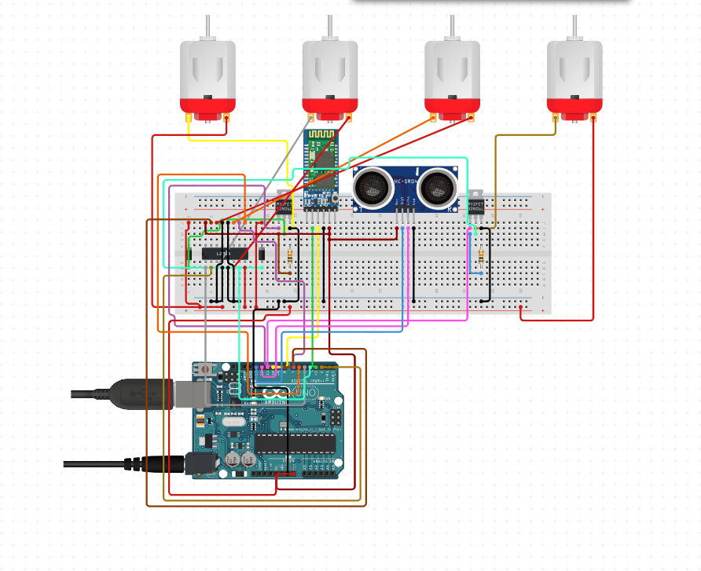
Circuit Diagram

Slide 14
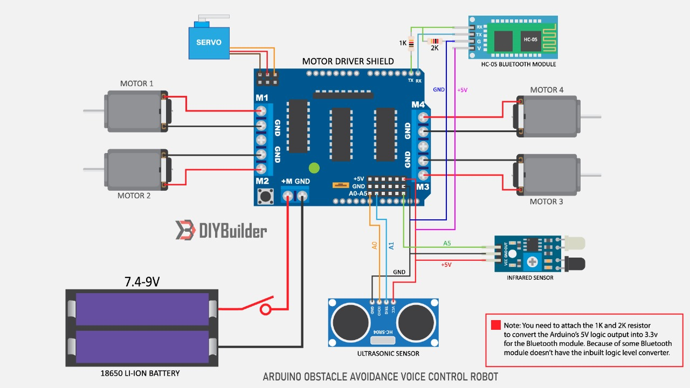
Circuit Diagram

Slide 15
Programming
ncu-lab-manual-and-end-semester-projects/NCU-CSL349 - AIR - End Semester Project at main · piyush-gambhir/ncu-lab-manual-and-end-semester-projects (github.com)

Slide 16
Result & Discussion
The car performed effectively in our tests, demonstrating reliable obstacle avoidance. However, we observed some limitations in handling narrow spaces, which will be addressed in future enhancements.

Slide 17
Future Improvements
We plan to incorporate more advanced sensors, such as infrared or LIDAR, for improved detection capabilities. Further development will also involve refining the navigation algorithm and possibly upgrading the microcontroller for enhanced processing power.

Slide 18
Conclusion
To conclude, our project successfully demonstrates the capabilities of an Arduino-based autonomous vehicle. We have learned a great deal about robotics, sensor integration, and wireless communication through this project. We look forward to improving this prototype and exploring more complex applications in the future.

Slide 19
Thank You!
Piyush Gambhir (21CSU349)
Himanshu (21CSU324)
Ankit (21CSU277)
Riten (21CSU318)

